Slide 1

MINI PROJECT | DAV LAB
FOOD WASTE
ANALYTICS
and Management System
Forecasting, regression and kitchen action protocols for large-scale dining facilities
Presented by: [Name / Roll No. / Department]

Slide 2
1. Introduction
Hostel messes, canteens and hospital kitchens cook hundreds of kg daily under volatile demand.
1
1.05 bn
Planning is guesswork, so over-preparation is chronic.
tonnes of food wasted globally each year (UNEP). Institutional kitchens contribute over 26%.
2
Logging Prepared vs Served vs Wasted turns waste into a data problem we can optimise.
3

Slide 3

2. Problem Statement
!
Volatile attendance
Exams, holidays and weekends swing headcount; batch sizes stay fixed.
%
Over-preparation
A 15–25% safety buffer guarantees daily leftovers.
₹
Cost and climate
₹45–80 lost per kg, 2.5 kg CO₂e per kg landfilled.

Slide 4
3. Objectives
1
2
3
Multi-dimensional EDA by category, facility, meal and cause
IQR-based outlier and anomaly detection
Time-series forecasting: MA, EWMA, ARIMA(1,1,1)
4
5
6
Regression to quantify prep-to-waste sensitivity
What-if simulator for 0–50% reduction targets
Auto-generated priority kitchen protocols

Slide 5

4. Existing System
Today
Limitations
Handwritten paper registers
Static Excel archives
Chef intuition sets quantity
Data reviewed weeks late
No root-cause attribution
No demand forecasting
Lakhs lost, no visibility

Slide 6
5. Proposed System
1
Mass-balance validation
Prepared = Served + Wasted, enforced on every record
2
Executive KPI dashboard
Waste kg, rate %, cost INR, meals, CO₂e
3
Forecasting suite
Moving average, EWMA, decomposition, 14-day ARIMA
4
Regression + what-if simulator
Test policy cuts, see projected savings
5
Action recommendations
Priority-ranked protocols with audit steps

Slide 7
6. System Architecture
1
2
3
4
Data Layer
Preprocessing
Analytics + ML
Presentation
SQLite database + CSV ingestion
420 meal observations
Mass-conservation checks
Type coercion, IQR anomaly profiler
Correlation, MA, EWMA, ARIMA
Scikit-learn regression
Streamlit dashboard
What-if simulator, protocols
Data flows left to right: log, validate, analyse, decide

Slide 8
7. Technologies Used
Software
Hardware
Python 3.11
Streamlit
Processor: Core i5 / Ryzen 5, quad-core
RAM: 8 GB minimum
Storage: 500 MB free
OS: Windows 10/11, macOS, Ubuntu
Plotly
Pandas / NumPy
Scikit-learn
Statsmodels
SQLite 3

Slide 9
8. Methodology
1
2
3
4
Ingest + validate
Explore + detect
Forecast
Model + simulate
Load 420 logs, enforce Prepared = Served + Wasted
Pareto categories, IQR outlier days
7-day MA, EWMA α=0.30, decomposition, ARIMA 14-day
OLS regression, what-if engine, 6 protocols

Slide 10

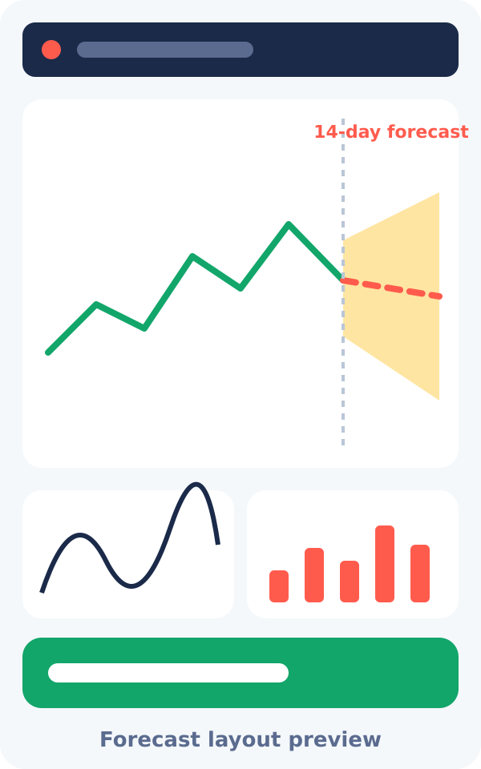
9. Implementation / Screenshots
1
Executive Hub: KPIs and charts
2
Ingredient and recipe analytics
3
Time-series forecasting
4
What-if portion simulator
5
Action recommendations
6
Live observation terminal

Slide 11
10. Results and Discussion
15.2%
₹4.68 L
r = 0.689
R² = 0.474
waste rate (7,800+ of 51,000+ kg)
ingredient cost wasted
prep vs waste correlation
regression fit, RMSE 12.3 kg
Rice (24.4%) and Bread (17.3%) cause 41.7% of loss
Every extra 100 kg cooked adds ~15 kg waste
Hostel Mess is highest at 2,355 kg, driven by weekend anomaly days

Slide 12
11. Advantages and Applications
Advantages
Applications
Turns data into ready kitchen actions
Forecasts demand before cooking
15–25% waste reduction target
Reports CO₂e and meals saved
Zero hardware cost
University and hostel messes
Corporate cafeterias
Hospital kitchens
Event catering and banquets
Surplus food donation to NGOs

Slide 13

12. Conclusion and Future Scope
Conclusion
Future Scope
Built an end-to-end analytics system for institutional food waste
Over-preparation (48%) and Rice/Bread (41.7%) are the main failure points
Forecasting plus regression gives a path to 15–25% reduction
IoT smart load-cell bins
Computer vision tray scanners
Turnstile data for prep planning
Automated NGO dispatch

